Slide 1
The teachers who will use the content in their own classroom may explain all the words if needed .
The teachers are requested to follow the notes
given below the slides.

Slide 2
Prepared & Presented by:
ISMAT ARA MAMATAZ
Assistant Teacher (English)
Dhanmondi Govt. Boys’
High School
Dhanmondi, Dhaka

Slide 3
Good Afternoon
WELCOME TO MY GRAMMAR CLASS

Slide 4
What are the children doing in the video?
https://www.youtube.com/watch?v=BwxSSq1BDtQ
Notes:
After showing the video clip, 4/5 learners will be asked to answer the question. The learners can be asked for acting out the action they have watched on the video.

Slide 5
Today’s Topic
Main Verbs
Class-6
Unit-v, Lesson-1

Slide 6
Learning Outcomes
By the end of the lesson, the learners will be able to…
identify main verbs.
describe its kinds.
make meaningful sentences using main verbs.

Slide 7
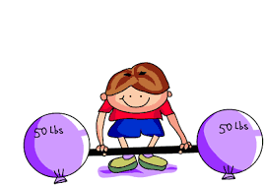
What is the boy doing ?
The boy is lifting weight.

Slide 8
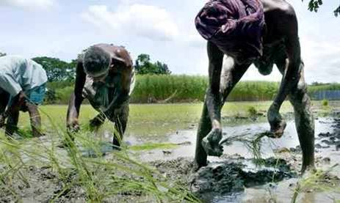
What do you see in the picture?
The farmers work/ are working in the field.
Notes:
The teacher may ask the learners to say something on the picture.

Slide 9
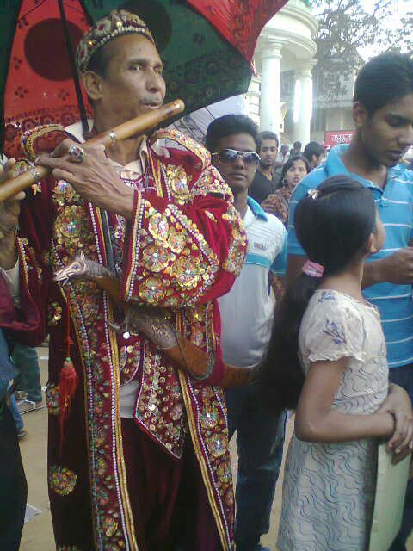
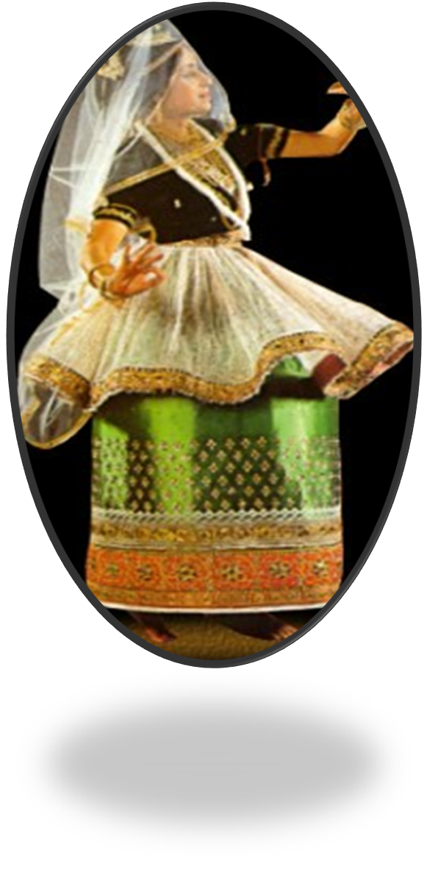
The piper plays at a flute.
You dance.
Notes:
The leaners will be asked for making more sentences following the given picture. The teacher will explain use of s/es with the verbs.

Slide 10
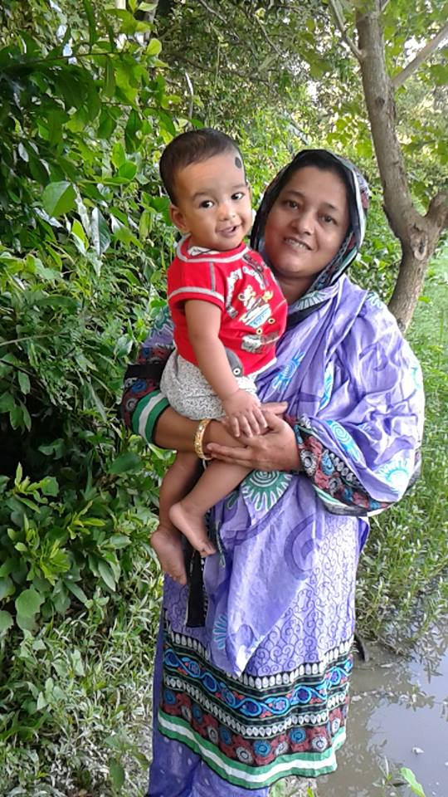
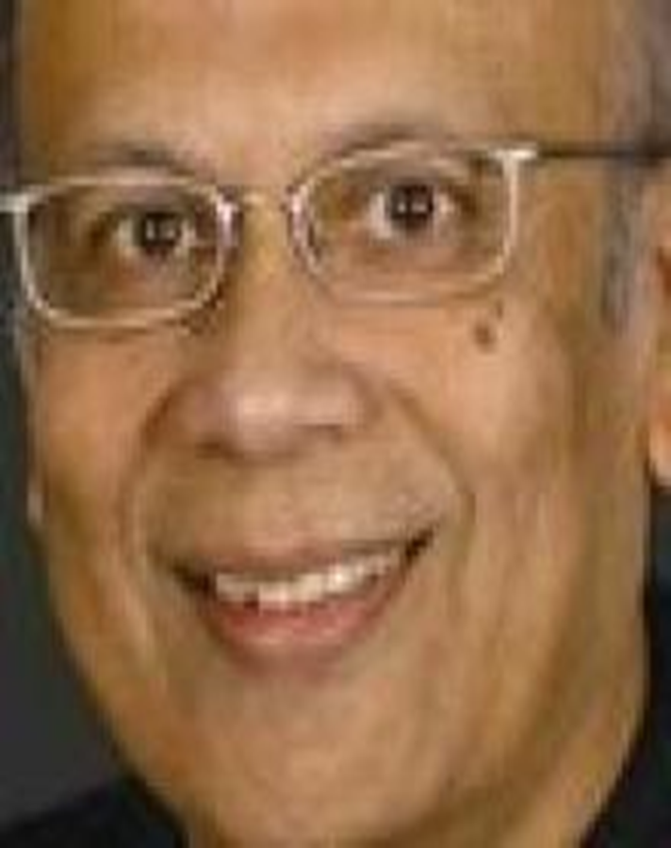
Every mother loves her child
Notes:
The leaners will be asked for making more sentences following the given picture. The teacher will explain use of s/es with the verbs.

Slide 11
Make sentences with the following verbs.
Notes:
The teacher may elicit answers or may give a writing work. Then may evaluate the answers through cross checking the answer scripts among the learners.

Slide 12
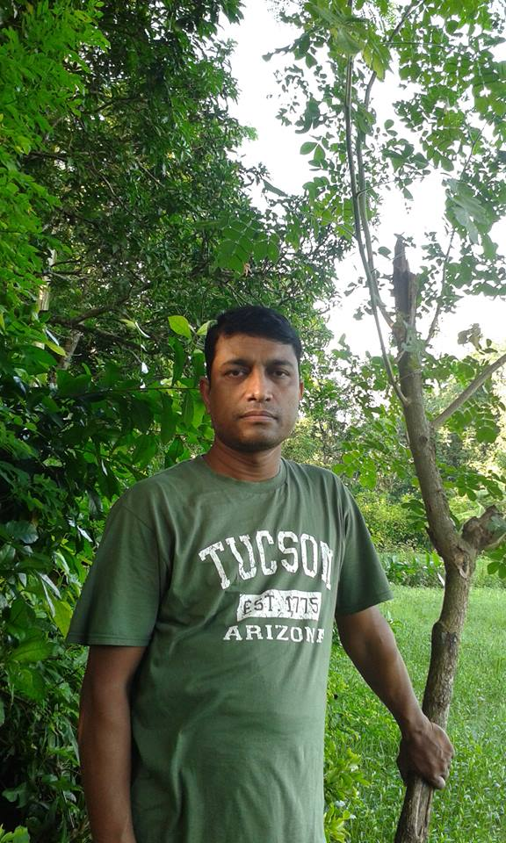
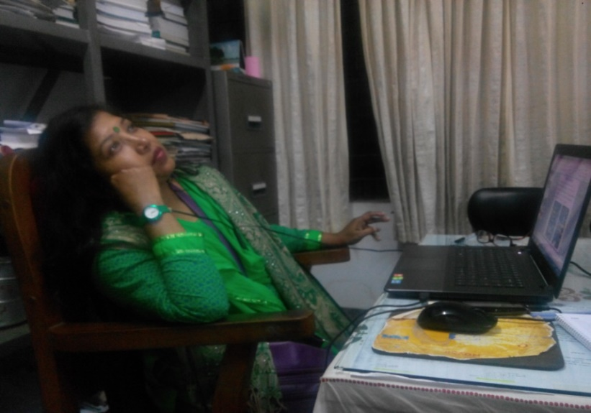
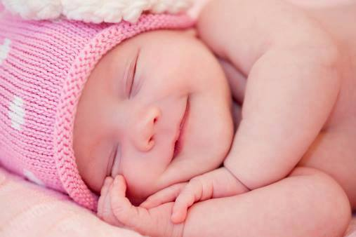
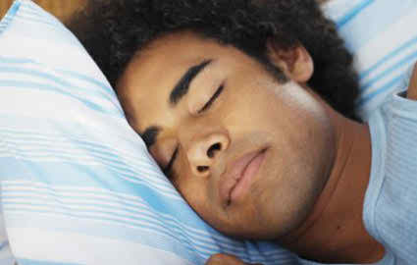
She is resting on the chair.
Sorwar is standing beside the tree.
Verbs of rest or position
The man is sleeping
The baby is lying on bed.

Slide 13
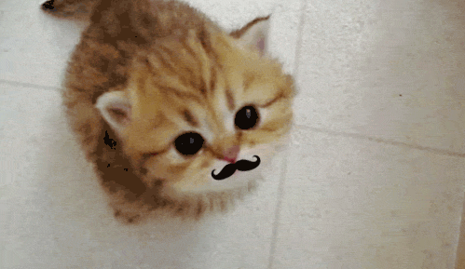
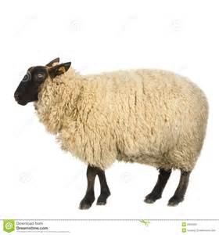
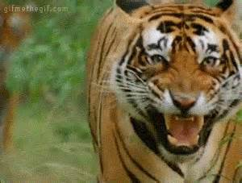
Verbs of sound
Verbs of sound
Cats mew.
The dog barks
Birds twitter.
Sheep bleat
Tigers growl.
Notes:
Showing the pictures the learners may be asked to guess the sounds of the animals and then he /she can show the texts. At last will announce the type of verbs. For practice the more sound s may be invited from the learners through writing.

Slide 14
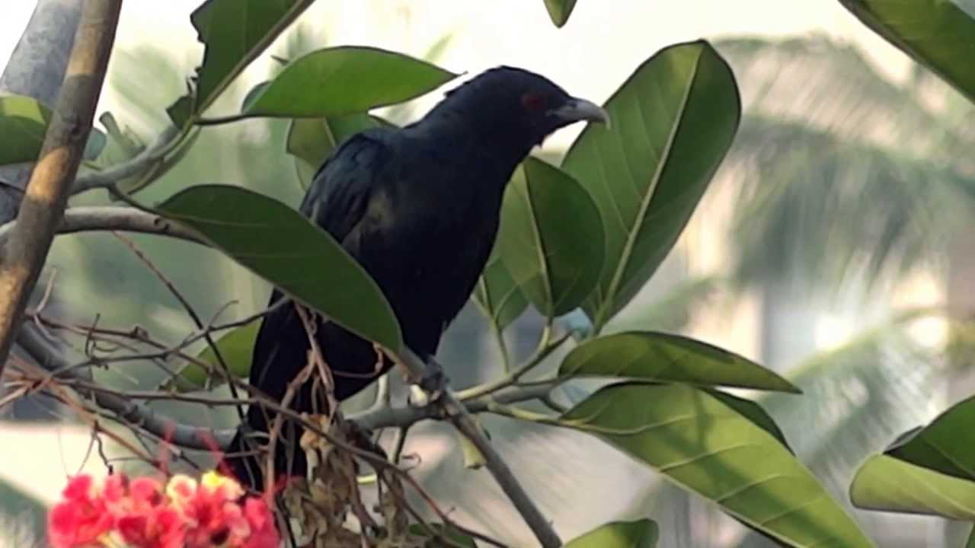
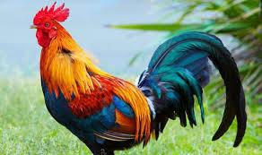
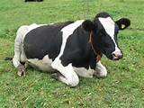
Now match the sounds with the following pictures and make sentences with them.
mow, coo, cooh
Notes:
The teacher may give more exercises on the board.

Slide 15
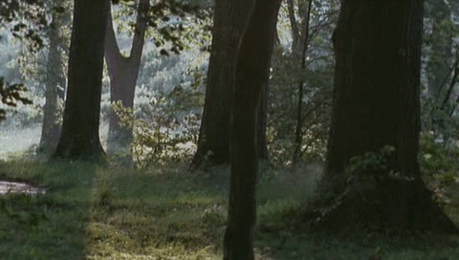
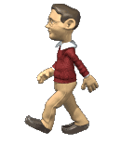
Choose the best answers.
Can you listen to the wind roaring/ barking /twittering?
The man is walking/running/jogging.
Notes:
The teacher may give them more exercises on the board.

Slide 16
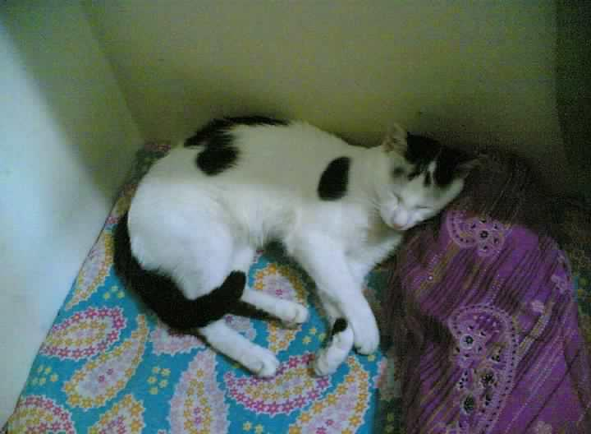
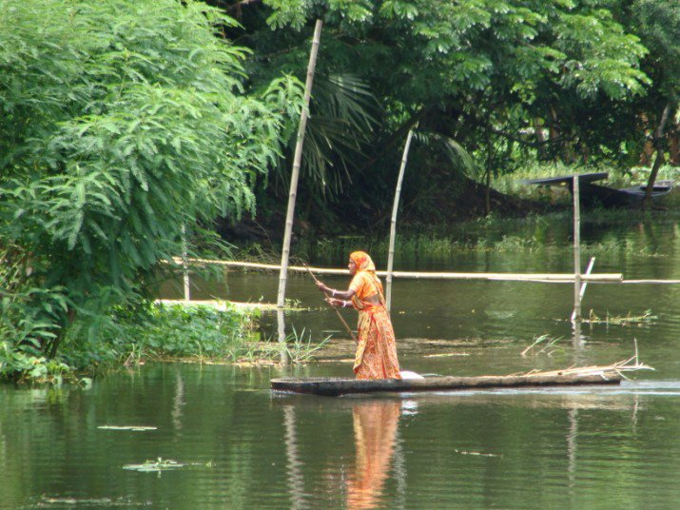
What do you see in the pictures?
Pao .
is crossing
is sleeping
The woman the canal.
.

Slide 17
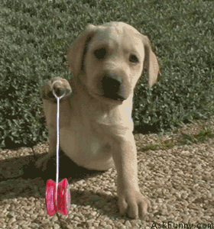
What is the puppy doing?
The puppy is playing.
Intransitive verb
An intransitive verb doesn’t have any object.
The puppy is playing with a yo-yo.
Transitive verb
A transitive verb has an object.

Slide 18
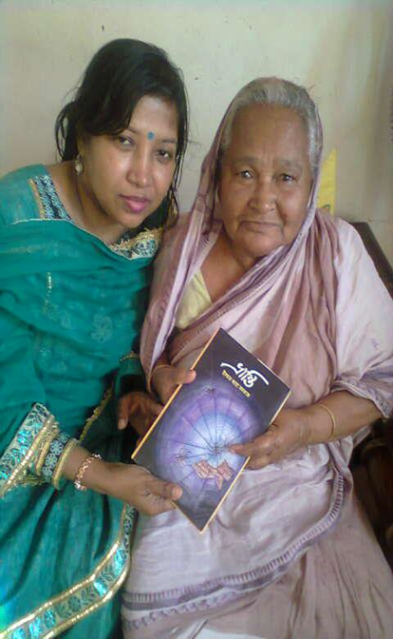
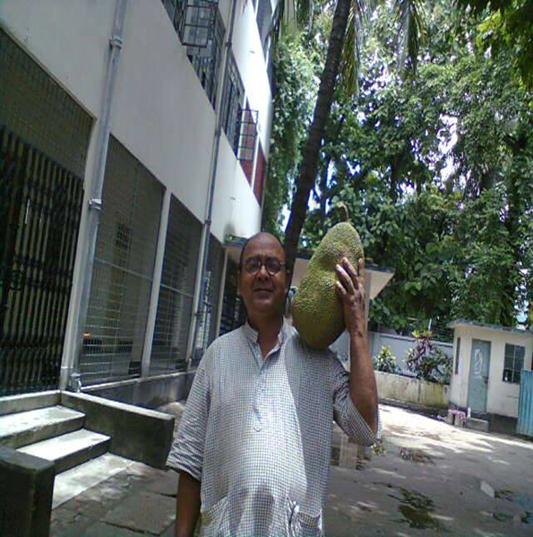
Ms. Shahana enjoys reading.so
She likes receiving books.
Mr. Komol carries a jackfruit. Mr. Komol likes to eat jackfruits. Infinitive phrase
n
Gerund
Notes:
The object will be explained by the teacher on the board.

Slide 19
Pair work
Discuss the pictures with your partners.
Then match the given verbs with them.
sing, debate, gossip,
feed and weep
Notes:
The teacher may elicit the answer or give a writing work

Slide 20
Fill in the blanks using the verbs.
1 The farmer is ……………… in the field.
2.Birds ………… in the sky.
3.I don’t know how to………..
4.He …… a song sweetly.
5. Mangos …………… sour.
6.I ….. a sound sleep.
7.He ……. a story book.
8.I like to….. grapes.
Notes:
The teacher can check the writing through interchanging the sheets within the learners. here the answer have been given- working, fly, swim, taste, eat slept,reads.

Slide 21
HOME WORK
Make 10 meaningful sentences using main verbs.

Slide 22
Thank you so much

Slide 23
Acknowledgement
MoE, DSHE, NCTB & A2I respective officials
And the editors panel:
Mr. Ranjit Poddar, Associate Prof, TTC, Dhaka,
Mr. Md. Jahangir Hasan, Asst. Prof, TTC, Rangpur,
Urmila Khaled Asst. Prof, TTC, Dhaka.
Their direction, valuable suggestions and intensive supervision have enriched the model contents.

